Slide 1
CHAPTER 10 Building an Organization Capable of Good Strategy Execution: People, Capabilities, and Structure

Slide 2
LEARNING OBJECTIVES
THIS CHAPTER WILL HELP YOU UNDERSTAND:
What managers must do to execute strategy successfully
Why hiring, training, and retaining the right people constitute a key component of the strategy execution process
That good strategy execution requires continuously building and upgrading the organization’s resources and capabilities
What issues to consider in establishing a strategy-supportive organizational structure and organizing the work effort
The pros and cons of centralized and decentralized decision making in implementing the chosen strategy

Slide 3
EXECUTING STRATEGY
Strategy execution
Is operations-driven, involving management of both people and business processes
Is a job for the whole management team, not just a few senior managers
Can take many more years to develop as a real proficiency than implementing strategy
Requires a determined commitment to change, action, and performance

Slide 4
A FRAMEWORK FOR EXECUTING STRATEGY
Committing to executing a strategy:
Entails figuring out the specific techniques, actions, and behaviors necessary for a smooth strategy-supportive operation
Following through to get things done and deliver results
Making things happen (leadership) and making them happen right (management)

Slide 5
Core Concept (1 of 5)
Good strategy execution requires a team effort. All managers have strategy-executing responsibility in their areas of authority, and all employees are active participants in the strategy execution process.

Slide 6
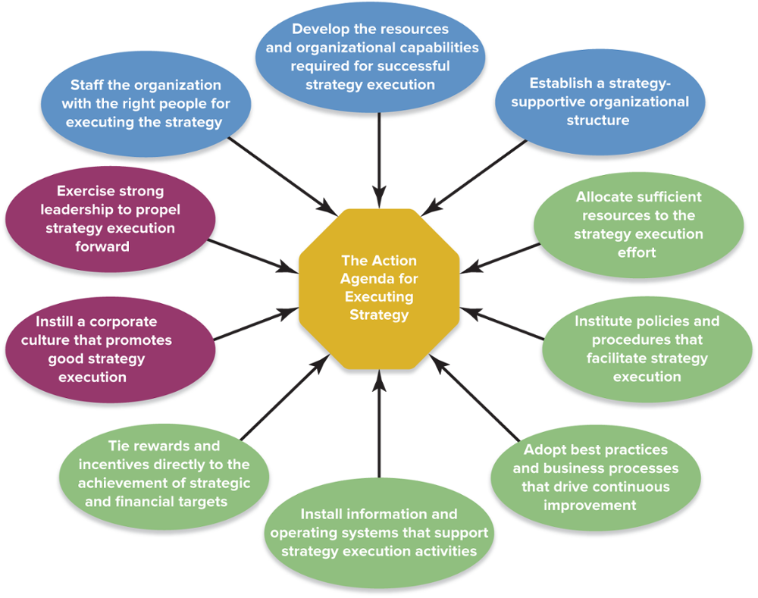
FIGURE 10.1 The 10 Basic Tasks of the Strategy Execution Process
Jump to Appendix 1 long image description

Slide 7
Strategic Management Principle (1 of 11)
When strategies fail, it is often because of poor execution. Strategy execution is therefore a critical managerial endeavor.
The two best signs of good strategy execution are whether a company is meeting or beating its performance targets and whether they are performing value chain activities in a manner that is conducive to companywide operating excellence.

Slide 8
BUILDING AN ORGANIZATION CAPABLE OF GOOD STRATEGY EXECUTION: THREE KEY ACTIONS
Staffing: Assemble a strong management team and a cadre of competent employees
Developing: Renew, upgrade, and revise resources and capabilities to match chosen strategy
Structuring: Create strategy-supportive organization capable of good strategy execution

Slide 9
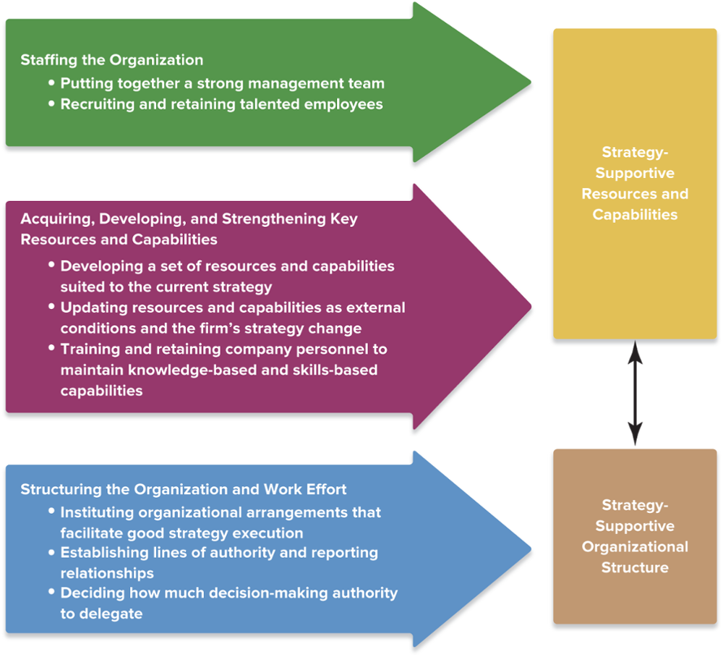
FIGURE 10.2 Building an Organization Capable of Proficient Strategy Execution: Three Types of Paramount Actions
Jump to Appendix 2 long image description

Slide 10
Strategic Management Principle (2 of 11)
Putting together a talented management team with the right mix of experiences, skills, and abilities to get things done is one of the first steps to take in launching the strategy-executing process.

Slide 11
STAFFING THE ORGANIZATION
Putting together a strong management team
Planners who ask tough questions and figure out what needs to be done
Implementers who can select, manage, and lead the right people
Executors who turn decisions into actions that drive the changes that produce sustainable competitive advantage
Key takeaway
A critical mass of talented activist managers

Slide 12
Strategic Management Principle (3 of 11)
In many industries, adding to a company’s talent base and building intellectual capital are more important to good strategy execution than additional investments in capital projects.

Slide 13

Management Development at Deloitte Touche Tohmatsu Limited
Clear path to partnership
Learning and development programs that contribute to Deloitte’s successful execution of its talent strategy
Formal training programs
Special programs for high performers
Sponsorship, not mentorship
Jump to Appendix 3 long image description

Slide 14
RECRUITING, TRAINING, AND RETAINING CAPABLE EMPLOYEES
Intensively screen and evaluate applicants to ensure selecting those who are best-suited and best-fitted
Provide training programs throughout employee careers
Offer challenging, interesting, and skill-stretching assignments
Rotating people through jobs that span functional or geographic boundaries
Make the work environment stimulating and engaging so that the firm is considered a great place to work
Encourage employees to propose creative ways of operating better, and to push ideas for new products or businesses
Use assorted financial incentives and perks to retain employees
Coach average performers to improve their skills and capabilities, while weeding out underperformers

Slide 15
Strategic Management Principle (4 of 11)
The best companies make a point of recruiting and retaining talented employees; the objective is to make the firm’s entire workforce (managers and rank-and-file employees) a genuine competitive asset.

Slide 16



DEVELOPING AND BUILDING CRITICAL RESOURCES AND CAPABILITIES
Approaches to Building and Strengthening Capabilities
Develop capabilities internally
Acquire capabilities through mergers and acquisitions
Access capabilities via collaborative partnerships
Jump to Appendix 4 long image description

Slide 17
Strategic Management Principle (5 of 11)
Building new competencies and capabilities is a multistage process that occurs over a period of months and years. It is not something that is accomplished overnight.

Slide 18

DEVELOPING CAPABILITIES INTERNALLY
Managerial Actions to Develop Competencies and Capabilities
Strengthen the firm’s base of skills, knowledge, and intellect
Coordinate and integrate the efforts of work groups and departments
Jump to Appendix 5 long image description

Slide 19
Strategic Management Principle (6 of 11)
A company’s capabilities must be continually refreshed and renewed to remain aligned with changing customer expectations, altered competitive conditions, and new strategic initiatives.

Slide 20
SETTING STRETCH GOALS: FROM CAPABILITY TO COMPETENCE
Thinking
strategically
about a firm’s
knowledge and skills base
Setting a stretch goal of developing an organizational ability to do something well
Evolving the ability into a competence or capability by performing it well and at an acceptable cost
Thinking strategically
about a firm’s
opportunities and challenges
Refreshing, updating, and upgrading competencies and capabilities as necessary to gain and maintain competitive advantage
Jump to Appendix 6 long image description

Slide 21
ACQUIRING CAPABILITIES THROUGH MERGERS AND ACQUISITIONS
A question of market opportunity | When a market opportunity can slip by faster than a needed capability can be created internally
A question of competitive necessity | When industry conditions, technology, or competitors are moving at such a rapid clip that time is of the essence
A question of successful integration | Tacit knowledge and complex routines may not transfer readily from one organizational unit to another

Slide 22
ACCESSING CAPABILITIES THROUGH COLLABORATIVE PARTNERSHIPS
Approaches to Acquiring Capabilities from an External Source
Outsource the function requiring the capabilities to a key supplier or another provider
Collaborate with a firm that has complementary resources and capabilities
Engage in a collaborative partnership for the purpose of learning how the partner does things
Jump to Appendix 7 long image description

Slide 23
THE STRATEGIC ROLE OF EMPLOYEE TRAINING
Training is important in:
Executing a strategy that requires different skills, competitive capabilities, and operating methods
Organizational efforts to build skills-based competencies
Supplying technical know-how to employees when rapidly changing technology puts a firm in danger of losing its ability to compete

Slide 24
STRATEGY EXECUTION CAPABILITIES AND COMPETITIVE ADVANTAGE
Superior strategy execution capabilities:
Are difficult to imitate and socially complex processes that take a long time to develop.
Maximize organizational resources and competitive capabilities in support of the business model
Lower costs and permit firms to deliver more value to customers
Enable a firm to react more quickly to market changes, beat competitors to market with new products and services, and gain uncontested market dominance

Slide 25
Zara’s Strategy-Execution Capabilities: Fast Fashion Retailer
Strategy is focused on rapid value chain execution
Quick and flexible design-to-production process
Close proximity to manufacturing factories
Lower percentage of commitment to fashion lines than competitors to keep in-store items fresh
Small lot-size orders reduce retail discounting, and encourage impulse-buying and frequent shopping
Placement of goods in proximity to high-fashion stores as a substitute for advertising

Slide 26
Strategic Management Principle (7 of 11)
Superior strategy execution capabilities are the only source of sustainable competitive advantage when strategies are easy for rivals to copy.

Slide 27
MATCHING ORGANIZATIONAL STRUCTURE TO THE STRATEGY
Ensuring that structure follows strategy by:
Deciding which value chain activities to perform internally and which to outsource
Aligning the firm’s organizational structure with its strategy
Determining how much authority to delegate
Facilitating collaboration with external partners and strategic allies

Slide 28
Strategic Management Principle (8 of 11)
A company’s organizational structure should be matched to the particular requirements of implementing the firm’s strategy.

Slide 29
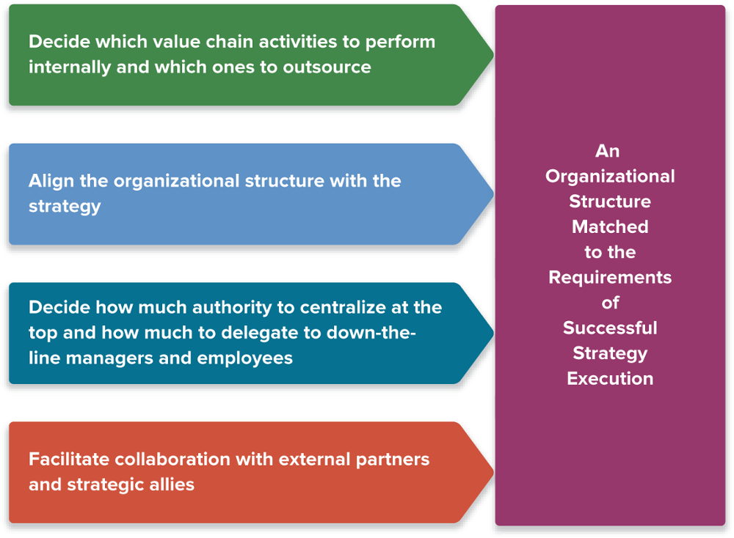
FIGURE 10.3 Structuring the Work Effort to Promote Successful Strategy Execution
Jump to Appendix 8 long image description

Slide 30
DECIDING WHICH VALUE CHAIN ACTIVITIES TO PERFORM INTERNALLY AND WHICH TO OUTSOURCE
Outsourcing’s execution-related benefits
Helps in outperforming rivals in strategy-critical activities and in turning a competence into a distinctive competence
Decreases bureaucracies, flattens structure, speeds decision making, and shortens response time to changing market conditions
Adds to a firm’s capabilities and contributes to better strategy execution through partnerships with suppliers and channel partners

Slide 31
Strategic Management Principle (9 of 11)
Wisely choosing which activities to perform internally and which to outsource can lead to several strategy-executing advantages: lower costs, heightened strategic focus, less internal bureaucracy, speedier decision making, and a better arsenal of organizational capabilities.

Slide 32
Which Value Chain Activities Does Apple Outsource and Why?
How important is outsourcing to Apple’s marketplace success?
Is outsourcing to low-wage overseas manufacturers to avoid paying higher wages in markets where it sells the majority of its products a failure of corporate social responsibility by Apple?

Slide 33
ALIGNING THE FIRM’S ORGANIZATIONAL STRUCTURE WITH ITS STRATEGY
Organizational structure
Comprises the formal and informal arrangement of tasks, responsibilities, lines of authority, and reporting relationships for the firm
Structure is aligned with strategy when:
Its design contributes to the creation of value for customers
Its parts are aligned with one another and also matched to the requirements of the strategy
It lowers operating costs through lower bureaucratic costs and operational efficiencies

Slide 34
Core Concept (2 of 5)
A firm’s organizational structure comprises the formal and informal arrangement of tasks, responsibilities, lines of authority, and reporting relationships by which the firm is administered.

Slide 35
MATCHING TYPE OF ORGANIZATIONAL STRUCTURE TO STRATEGY EXECUTION REQUIREMENTS
Simple Structure (Line-and-Staff)
Strategy Execution Requirements: Chosen Strategy
Capabilities and Competencies
Centralized or Decentralized Control
Functional Structure (Departmental or Unitary)
Multidivisional Structure (Divisional or M-form)
Matrix Structure (Composite or Combination)
Jump to Appendix 9 long image description

Slide 36
Core Concepts (3 of 5)
A simple structure (line-and-staff structure) consists of a central executive (often the owner-manager) who handles all major decisions and oversees all operations with the help of a small staff.
A functional structure is organized into functional departments, with departmental managers who report to the CEO and small corporate staff.

Slide 37
Core Concepts (4 of 5)
A multidivisional structure is a decentralized structure consisting of a set of operating divisions organized along business, product, customer group, or geographic lines, and a central corporate headquarters that allocates resources, provides support functions, and monitors divisional activities.
A matrix structure combines two or more organizational forms, with multiple reporting relationships. It is used to foster cross-unit collaboration.

Slide 38

DETERMINING HOW MUCH AUTHORITY TO DELEGATE
Centralized Decision Making
Organizational Approaches to Decision-Making
Decentralized Decision Making
Authority is retained by top management
Authority delegated to lower-level managers and employees
Jump to Appendix 10 long image description

Slide 39
BASIC TENETS OF CENTRALIZED VERSUS DECENTRALIZED DECISION MAKING
Centralized Organizational Structures | Decentralized Organizational Structures
Basic tenets | Basic tenets
Decisions on most matters of importance should be in the hands of top-level managers who have the experience, expertise, and judgment to decide what is the best course of action. | Decision-making authority should be put in the hands of the people closest to, and most familiar with, the situation.
Lower-level personnel have neither the knowledge, time, nor inclination to properly manage the tasks they are performing. | Those with decision-making authority should be trained to exercise good judgment.
Strong control from the top is a more effective means for coordinating company actions. | A company that draws on the combined intellectual capital of all its employees can outperform a command-and-control company.

Slide 40
CHIEF ADVANTAGES OF CENTRALIZED VERSUS DECENTRALIZED DECISION MAKING
Centralized Organizational Structures | Decentralized Organizational Structures
Chief advantages | Chief Advantages
Fixes accountability through tight control from the top | Encourages company employees to exercise initiative and act responsibly
Eliminates potential for conflicting goals and actions on the part of lower-level managers | Promotes greater motivation and involvement in the business on the part of more company personnel
Facilitates quick decision making and strong leadership in crisis situations | Spurs new ideas and creative thinking
 | Allows for fast response to market change
 | Entails fewer layers of management

Slide 41
PRIMARY DISADVANTAGES OF CENTRALIZED VERSUS DECENTRALIZED DECISION MAKING
Centralized Organizational Structures | Decentralized Organizational Structures
Primary disadvantages | Primary disadvantages
Lengthens response times by those closest to the market conditions because they must seek approval for their actions | May result in higher-level managers being unaware of actions taken by empowered personnel under their supervision
Does not encourage responsibility among lower-level managers and rank-and-file employees | Can lead to inconsistent or conflicting approaches by different managers and employees
Discourages lower-level managers and rank-and-file employees from exercising any initiative | Can impair cross-unit collaboration

Slide 42
Strategic Management Principle (10 of 11)
The ultimate goal of decentralized decision making is to put authority in the hands of those persons closest to and most knowledgeable about the situation.

Slide 43

CAPTURING CROSS-BUSINESS STRATEGIC FIT IN A DECENTRALIZED STRUCTURE
Enforcing close cross- business collaboration to avoid duplication of effort
Capturing Cross-Business Strategic Fit
Centralizing related functions requiring close coordination at the corporate level
Jump to Appendix 11 long image description

Slide 44
Strategic Management Principle (11 of 11)
Efforts to decentralize decision making and give company personnel some leeway in conducting operations must be tempered with the need to maintain adequate control and cross-unit coordination.

Slide 45
FACILITATING COLLABORATION WITH EXTERNAL PARTNERS AND STRATEGIC ALLIES
Creating a Network Structure: Using “relationship managers” to build and maintain cooperative arrangements of value both parties
Strategic alliances
Outsourcing arrangements
Joint ventures
Cooperative partnerships
Jump to Appendix 12 long image description

Slide 46
Core Concept (5 of 5)
A network structure is a configuration composed of a number of independent organizations engaged in some common undertaking, with one firm typically taking on a more central role.

Slide 47



FURTHER PERSPECTIVES ON STRUCTURING THE WORK EFFORT
Matching Structure to Strategy
Pick a basic organizational design that matches structure to strategy
Institute collaborative networking and communication arrangements
Supplement design with appropriate coordinating mechanisms
Jump to Appendix 13 long image description

Slide 48
Appendix 1 Figure 10.1 The 10 Basic Tasks of the Strategy Execution Process
Staff the organization with managers and employees capable of executing the strategy well
Develop the resources and organizational capabilities required for successful strategy execution
Create a strategy-supportive organizational structure
Allocate sufficient resources (budgetary and otherwise) to the strategy execution effort.
Institute policies and procedures that facilitate strategy execution.
Adopt best practices and business processes that drive continuous improvement in strategy execution activities.
Install information and operating systems that enable company personnel to carry out their strategic roles proficiently.
Tie rewards and incentives directly to the achievement of strategic and financial targets.
Instill a corporate culture that promotes good strategy execution.
Exercise the internal leadership needed to propel strategy implementation forward.
Return to slide

Slide 49
Appendix 2 Figure 10.2 Building an Organization Capable of Proficient Strategy Execution: Three Types of Paramount Actions
Staffing the organization. This includes putting together a strong management team and recruiting and retaining talented employees.
Acquiring, developing and strengthening key resources and capabilities. This action includes developing a set of resources and capabilities suited to the current strategy; updating resources and capabilities as external conditions and the firm's strategy change; and finally, training and retaining company personnel to maintain knowledge-based and skills-based capabilities.
Structuring the organization and work effort. The steps for this action include instituting organizational arrangements that facilitate good strategy execution; establishing lines of authority and reporting relationships; and deciding how much decision-making authority to delegate.
These actions will lead to both strategy-supportive resources and capabilities, and a strategy-supportive organizational structure.
Return to slide

Slide 50
Appendix 3 Management Development at Deloitte Touche Tohmatsu Limited
In the beginning, the employee gains broad exposure through building a broad consulting experience. Next, an employee will focus in a field of interest, driving delivery and building expertise within this field. Finally, eminence is developed in the chosen field, and it is here that the expertise is broadly applied.
A clear path to partnership, formal training programs, special programs for high performers, and sponsorship, not mentorship, are all learning and development programs that contribute to Deloitte's successful execution of its talent strategy.
Return to slide

Slide 51
Appendix 4 Developing and Building Critical Resources and Capabilities
Three approaches to building and strengthening capabilities are:
Developing capabilities internally
Acquiring capabilities through mergers and acquisitions
Accessing capabilities via collaborative partnerships
Return to slide

Slide 52
Appendix 5 Developing Capabilities Internally
In order to develop competencies and capabilities internally, managers should strengthen the firm's base of skills, knowledge, and intellect. They should also coordinate and integrate the efforts of work groups and departments.
Return to slide

Slide 53
Appendix 6 Setting Stretch Goals: From Capability to Competence
Five steps take a stretch goal from capability to competence:
Thinking strategically about a firm's knowledge and skills base
Setting a stretch goal of developing an organizational ability to do something well
Evolving the ability into a competence or capability by performing it well and at an acceptable cost
Thinking strategically about a firm's opportunities and challenges
Refreshing, updating, and upgrading competencies and capabilities as necessary to gain and maintain competitive advantage
Return to slide

Slide 54
Appendix 7 Accessing Capabilities Through Collaborative Partnerships
Acquiring capabilities from an external source can be done by:
Outsourcing the function requiring the capabilities to a key supplier or another provider
Collaborating with a firm that has complementary resources and capabilities
Engaging in a collaborative partnership for the purpose of learning how the partner does things
Return to slide

Slide 55
Appendix 8 Figure 10.3 Structuring the Work Effort to Promote Successful Strategy Execution
To create an organizational structure that is matched to the requirements of successful strategy execution, the following actions should be taken
Decide which value chain activities to perform internally and which ones to outsource
Align the organizational structure with the strategy
Decide how much authority to centralize at the top and how much to delegate to down-the-line managers and employees
Finally, facilitate collaboration with external partners and strategic allies
This will structure the work effort to promote successful strategy execution
Return to slide

Slide 56
Appendix 9 Matching Type of Organizational Structure to Strategy Execution Requirements
The four types of organizational structures are: simple structure (line-and-staff), functional structure (departmental or unitary), multidivisional structure (divisional or M-form), and matrix structure (composite or combination).
The three strategy execution requirements are: chosen strategy, capabilities and competencies, and centralized or decentralized control.
Return to slide

Slide 57
Appendix 10 Determining How Much Authority to Delegate
In centralized decision making, authority in retained by top management. In decentralized decision making, authority is delegated to lower-level managers and employees.
Return to slide

Slide 58
Appendix 11 Capturing Cross-Business Strategic Fit in a Decentralized Structure
Capturing cross-business strategic fit includes enforcing close cross-business collaboration to avoid duplication of effort, as well as centralizing related functions requiring close coordination at the corporate level.
Return to slide

Slide 59
Appendix 12 Facilitating Collaboration with External Partners and Strategic Allies
"Relationship managers" can be used to build and maintain cooperative arrangements of value to both parties. They facilitate strategic alliances, outsourcing arrangements, joint ventures, and cooperative partnerships.
Return to slide

Slide 60
Appendix 13 Further Perspectives on Structuring the Work Effort
The progression of matching structure to strategy first begins by picking a basic organizational design that matches structure to strategy. Next, design is supplemented with appropriate coordinating mechanisms. Finally, collaborative networking and communication arrangements are instituted.
Return to slide

